Slide 1
Membership
2017

Slide 2
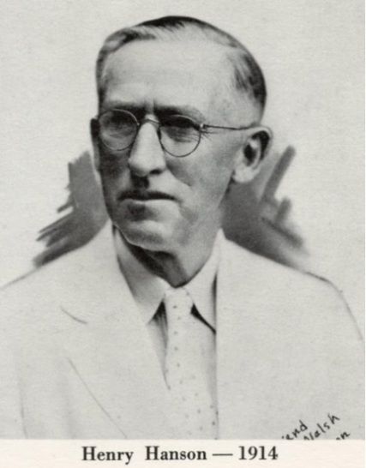
FPHA History
The first FPHA “Conference” was called in 1929 by the State Health Officer, Dr. Henry Hanson.
In 1931, the FPHA was formally chartered under its present name with Dr. Hanson as its first president.

Slide 3
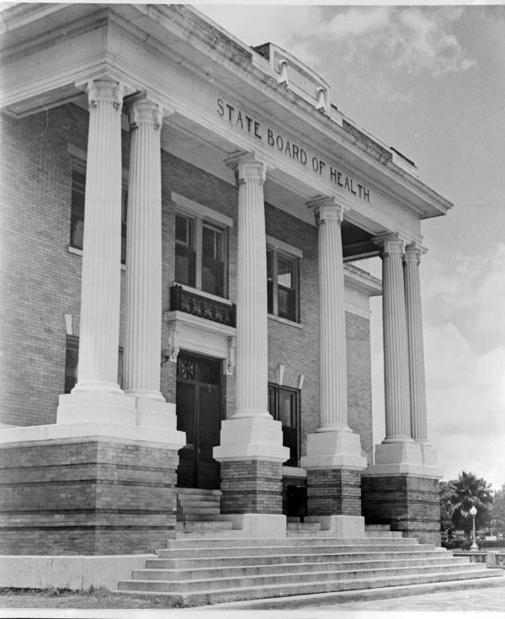
FPHA History (cont’d)
Since 1931, the FPHA has served as the voice for professionals and other supporters of strong, effective public health policies and legislation.
Through its annual meetings this association has provided education and has been the friendly meeting place for all concerned with public health in Florida.
1911 State Board of Health, Jacksonville, FL

Slide 4
Who We Are and Where We Are Going
Mission:
FPHA Serves Florida’s Public Health Professionals and Students through
Advocacy
Professional development
Networking
to Improve Florida’s Health
Vision:
FPHA will be the premier association that represents and supports Florida’s public health professionals and students in their provision of excellent public health services throughout the state.

Slide 5
FPHA Values: DRIVEN
Diverse membership
Responsiveness to members on public health issues
Innovative engagement with members in seeking new solutions to old problems
Valuable advocacy for public health
Education and promotion of evidence-based solutions to public health issues
Networking to strengthen relationships of public health professionals

Slide 6
FPHA Membership
Diverse as Public Health
Academicians | Alternative health care providers
Consumers | Dentists
Environmental health specialists | Epidemiologists
Food Safety professionals | Health educators
Health professionals | Interested citizens
Laboratorians | Nurses
Nutritionists | Physicians
Policymakers | Preventive medicine specialists
Social workers | Students

Slide 7
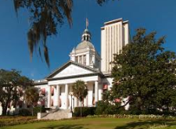
Advocacy
FPHA has worked to preserve public health funding for local health departments and statewide programs. Specifically, association members have advocated for:
The adoption of laws targeting public health safety including helmet and seatbelt use, child safety restraints, safe crosswalks, and texting while driving
Mandatory health education and 150 minutes of physical activity in public schools
Maintaining state laws for vaccinations
State Capital Building, Tallahassee, FL

Slide 8
Advocacy
Legislative Committee
Surveys members to identify legislative issues that are important to them
FPHA Lobbyist advocates for the FPHA supported issues
Follows the annual State Legislative Session (60 days in beginning of year)
Prepares legislative updates/alerts, and keeps track of public health issues under consideration by the State Legislature

Slide 9
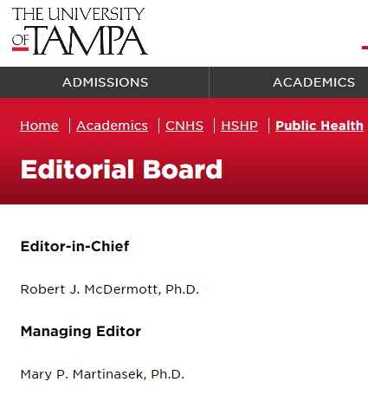
Professional Development
Strong supporter for public health education
Regional conferences
Annual Educational Conference
Peer Reviewed publication
Florida Public Health Review
http://www.ut.edu/floridapublichealthreview/

Slide 10
Professional Development
Scholarship Opportunities
Undergraduate Degree
An undergraduate student working on a degree in health-related or public health program may apply for a $300 scholarship.
Master’s or Doctoral Degree
A $500 scholarship to be used toward the attainment of a Master’s Degree or Doctoral Degree in Public Health or in the field of public health. Active members of FPHA are eligible.
Presented at the Annual Educational Conference

Slide 11
Networking
FPHA offers a number of interest groups that its members can be involved in. It is a great way to network with public health professionals in your field/area of interest.
Current Interest Groups are:
Chronic & Communicable Disease Prevention
Epidemiologists, lab professionals, nurses, environmental health, physicians, etc.
Community Health
Health educators, nutritionists, injury prevention, nurses, administration, environmental health, physicians, etc.

Slide 12
Networking
Current Interest Groups (cont’d)
Environmental Health and Protection
Environmental health, epidemiologist, lab professionals, educators, etc.
Health Equity
All public health professionals interested in the causes of differences in the quality of health and healthcare across different populations
Health Informatics and Information Technology
PIO’s, health educators, IT, administrators, nurses, epidemiologists, etc.

Slide 13
Networking
Current Interest Groups (cont’d)
Oral Health
Dentists, dental hygienists, etc.
Public Health Leadership
Administrators, business, finance, etc.
Public Health Nursing
Nurses, student nurses, etc.
Students
Full time

Slide 14
Professional Development and Networking
Annual Educational Conference - Theme: The Power of Collaboration
July 26-28, 2017 in Orlando, FL
Public Health speakers
Educational Sessions
Meet with FPHA members from across the state
Exhibitors
Silent Auction
The Florida Hotel, Orlando, FL

Slide 15
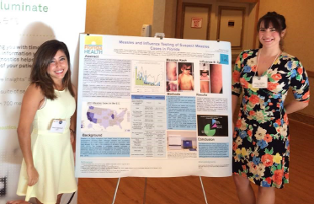
AEC Posters
Sheila Alaghemand and Alyssa Moffitt presenting their research poster at the 2015 AEC.

Slide 16
10 Great Reasons to Be a Member
1. Connection… with public health professionals in Florida.
2. Annual Educational Conference… provides quality education and networking for public health professionals, and you receive a significant discount by being a member. You can contribute to the content, help plan the Conference or attend to enhance your professional development.
3. Public Policy / Advocacy… contribute to the strong advocacy program centered on assuring that public health voices are being heard at the Florida State Capitol.

Slide 17
10 Great Reasons to Be a Member...
4. Free Informational Services… keeps members in touch with each other and current issues through the association’s web site, Facebook page, and email updates of emerging issues relevant to public health. You remain informed about public health in Florida in a way that saves you time.
5. Networking… building your contacts, sharing ideas, best practices and solutions to enhance your current job, find opportunities for career enhancement, etc. Networking events range from Annual Conferences to Regional meetings and being a part of an Interest Group.
6. Affiliation… over 600 public health professionals in Florida.

Slide 18
10 Great Reasons to Be a Member...
7. Discounts on Educational Offerings… reduced registration fees at all FPHA sponsored continuing education events.
8. Leadership Opportunities… to learn and practice leadership and meeting management skills that you may need for your resume, professional growth or self-promotion. Opportunities are available on the Board, committees and special projects.
9. Recognition… to be recognized or can recognize your colleagues for their achievements in public health. Some of our heroes work right next to us every day!

Slide 19
10 Great Reasons to Be a Member...
10. Empowerment… be part of a larger community. You are empowered to get involved in issues that affect your personal and professional communities and your quality of life.

Slide 20
Membership Dues
Health Agency Membership
Platinum Tier $1,500 (55 Employees)
Gold Tier $1,000 (33 Employees)
Silver Tier $500 (15 Employees)
Bronze Tier $250 (7 Employees)
Individual $45
Student $15
Senior $15

Slide 21
How about you? Are you a member?
Florida Public Health Association
14646 NW 151st Blvd.
Alachua, FL 32615
Email address: fpha@srahec.org
Website: http://www.fpha.org
Facebook: https://www.facebook.com/FLPublicHealth

